Slide 1
Summer Project Theme
052021
ATOM Summer Intern Program

Slide 2
Latent Space Optimization of GMD through Weighted Retraining using Pharmacodynamic Models
TEAM
Frank Alexander
Byung-Jun Yoon
Amanda Paulson
Belinda Akpa
Susan Mertins

Slide 3
Introduction
ATOM Cancer Model Working Group
Accelerate drug discovery development in cancer
10-12 years
$2 billion
Computational resources are (likely) world’s largest with new Partners in ATOM
Since December 2020, vetting of Proposals
Initiated by Byung-Jun Yoon and Frank Alexander at Brookhaven National Lab

Slide 4





The ATOM Platform Active Learning Drug Discovery Framework
Property Prediction Pipeline
Efficacy
Prediction & Design Loop
Multi-level models
Systems models
Safety
Working
Compound
Library
PK
Design Criteria
Developability
Generative Molecular Design
proposes new molecules with optimized properties
Active learning decides if/when a simulation or experiment is needed to improve or validate models
Retrain property prediction models
Molecular Feature
Simulations
Simulation
Human-relevant assays, complex in vitro models
Chemistry Design & Synthesis
Experiment

Slide 5
Project Overview
SUMMARY: Retrain Autoencoder using pharmacodynamic model of DNA Damage Response
STEP 1: Propose Lead Optimization for PARP inhibitors
Ample data available in public databases
STEP 2: New molecules will need to be vetted in the Prediction Profilers
SUMMER PROJECTS
STEP 3: New molecules will be placed in a pharmacodynamic model of DNA damage response
Quantitative output form ODE Model in RuleBender will be ratios of pro-apoptotic to pro-survival protein abundance
SUMMER PROJECTS
STEP4: Retrain Autoencoder

Slide 6
DNA Damage Response – Pharmacodynamic Model
Vitally important to normal cell function and borders checkpoints closely
Failure in repair leads to cell death
Interestingly, damage can result from intrinsic and extrinsic sources
Genomic instability is a hallmark of all cancers
Once initiated by faulty repair, may continue in an endless cycle of further instability and selection for
DDR therapeutic strategies offer many entry points for ATOM

Slide 7
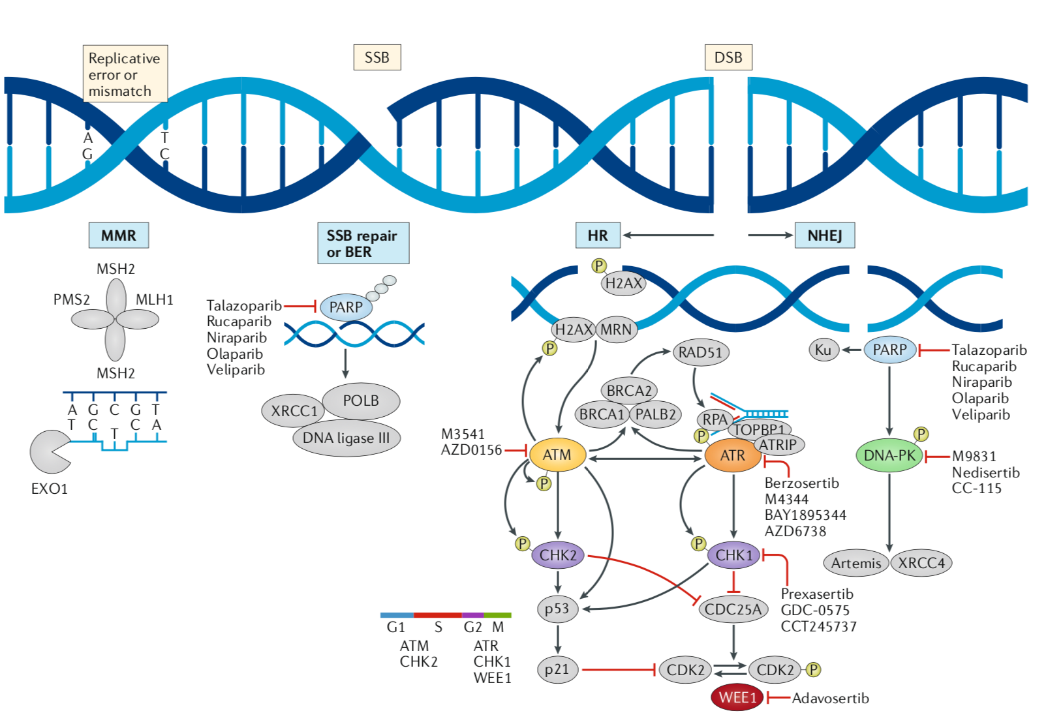
DNA Damage Response (Pilie, 2018)

Slide 8
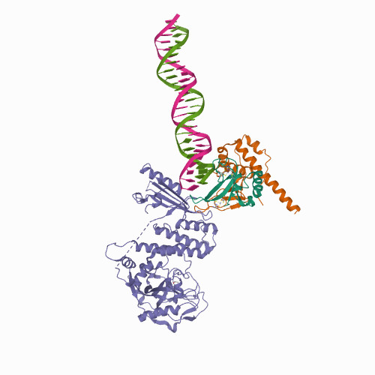
PARP as the Molecular Target of Interest
PARP family
17 - 18 members
Enzyme that adds post-translational modifications to other proteins
ADP-ribose derived from NAD
Short (1 unit) or long (200 units) chains
Act as scaffolds
PARylation (poly-ADP ribosylation)
Family members are distinct in location and targets
Binds to DNA at SSB and DSB and is activated to PARylate and auto-PARylate

Slide 9
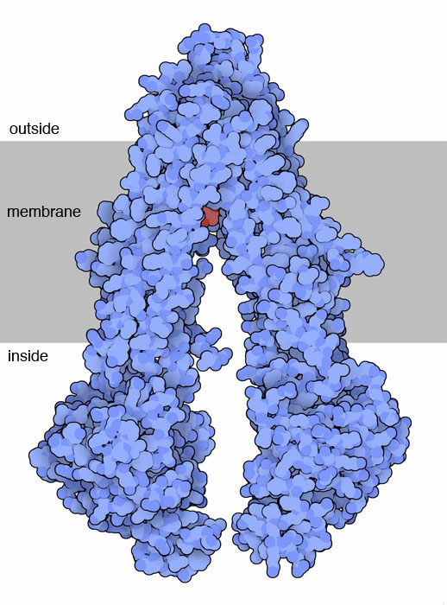
Blood Brain Barrier
Another Pilot Project is under consideration
PARP1 inhibitors in the clinic are ineffective on brain metastases
Can ATOM improve existing molecules that cross BBB
Prediction Profiler for particular ABC transporters would be useful in this regard
ABC transporter eject categories of molecules
E.g. P-glycoprotein binds cationic and hydrophobic molecules and with ATP, transports them out of the cytoplasm.
SUMMER PROJECTS

Slide 10
Rationale for Selection of DDR
Components of the DDR are druggable.
DDR disruption underlies all cancers as manifest in genomic instability, a hallmark.
DDR is central to apoptotic signals, thus inhibition may lead to cell death, a preferred anti-tumor consequence as the challenge of resistance based on mutation is eliminated.
Pathway has demonstrable synthetic lethality and thus subject to study to select biomarkers for patient stratification and therapeutic response. For example, PARP inhibitors and BRCA1/2 mutant tumors can be effectively treated for positive outcomes in some breast and ovarian cancer patients.
Like all pathways, drug resistance mechanisms can be investigated in a systems and therefore predictable fashion.
There are nearly no mechanistic DDR ODE Models as planned here.
A robust number of clinical trials are rationally combining other molecularly targeted drugs, but success continues to be limited by high grade toxicities (myelosuppression). The rationale is dependent on eliminating all repair processes, therefore triggering cell death.
Combination of anti-DDR agents is also being investigated with radiotherapy and immunotherapy.
The mechanistic DDR ODE Model may complement another Pilot Project, developing PARP inhibitors with pharmacology that allow CNS penetration.

Slide 11
QUESTIONS?

Slide 12
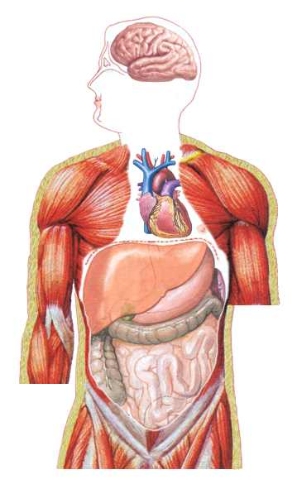
GMD and property prediction
[data-driven]
PBPK-PD
[mechanistic]
Design criteria
Human therapeutic value
Molecular optimization
Scores
Latent space optimization
GMD
Molecular candidates
Cl_{int}, pIC₅₀, f_{u}, B2P, pKa, logP
PBPK ODE model
latent vector representation
C(t)
SMILES representation
Pharmacodynamic pathway models
(DNA damage/repair)
Initial compound library
Molecular property prediction pipeline
Therapeutic outcome
e.g., pIC₅₀
Adverse outcomes

